Slide 1

PROJECT TITLE
Presented By:
SANIKA NITIN KHARADE
MIT ACADEMY OF ENGINERRING,ALANDI PUNE
COMPUTER ENGINEERING

Slide 2
OUTLINE
Problem Statement
Proposed System/Solution
System Development Approach
Algorithm & Deployment
Result (Output Image)
Conclusion
Future Scope
References

Slide 3
Problem Statement
In modern power systems, identifying and classifying faults quickly is critical to maintaining system stability and minimizing downtime. However, conventional manual techniques are time-consuming and error-prone. There is a growing need for intelligent systems that can detect and classify power system faults automatically using real-time data.

Slide 4
Proposed Solution
The proposed system aims to automate the process of detecting and classifying power system faults using machine learning. IBM Watson AutoAI will be used to develop and deploy the ML model. The solution involves:
Data Collection: Using a Kaggle dataset containing labeled power system fault data.
Preprocessing: Cleaning and transforming the dataset for model training.
Model Training: AutoAI will automatically select, train, and optimize the best models.
Deployment: Deploying the best model as an API for real-time fault classification.
Evaluation: Assessing the model using metrics like accuracy, precision, recall, and F1-score.

Slide 5
System Approach
Technologies Used:
IBM Watson Studio
IBM AutoAI
Python (for data preprocessing)
Kaggle dataset (Power system fault classification)
Libraries/Tools:
pandas, numpy, scikit-learn (used indirectly via AutoAI)
IBM Cloud Object Storage
IBM Watson Machine Learning

Slide 6
Algorithm & Deployment
Algorithm AutoAI :
AutoAI automatically evaluated multiple models such as Logistic Regression, Random Forest, Gradient Boosting, and XGBoost.The best-performing model was selected based on the highest accuracy.
Deployment:
The trained model was deployed as a RESTful API using IBM Watson Machine Learning for live predictions.
Training Process:
AutoAI split the dataset into training and testing sets.
Performed automated feature engineering, model selection, and hyperparameter optimization.
Prediction Process:
Input: Real-time or batch data with system parameters.
Output: Classified fault type (e.g., Line-to-Line, Line-to-Ground, No Fault).

Slide 7
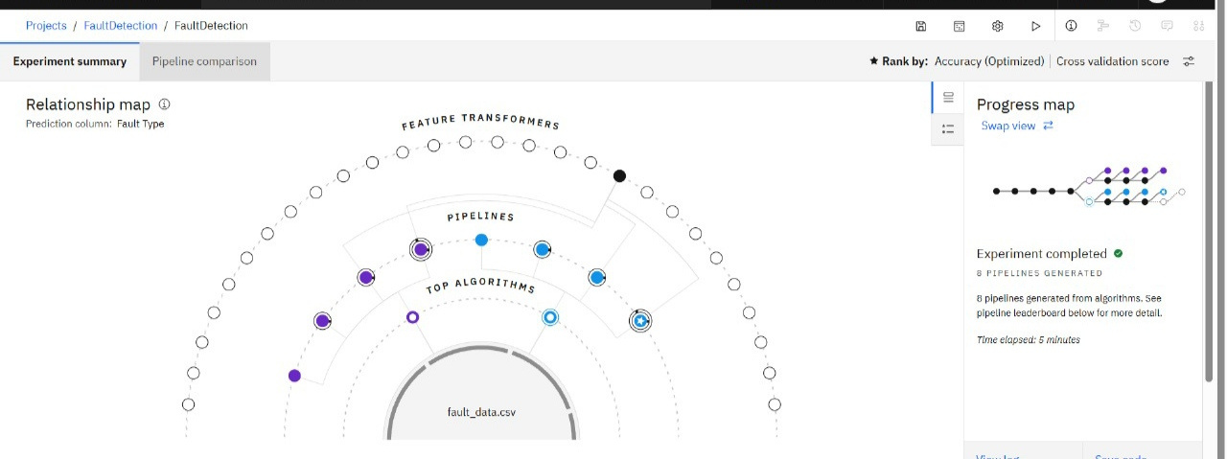
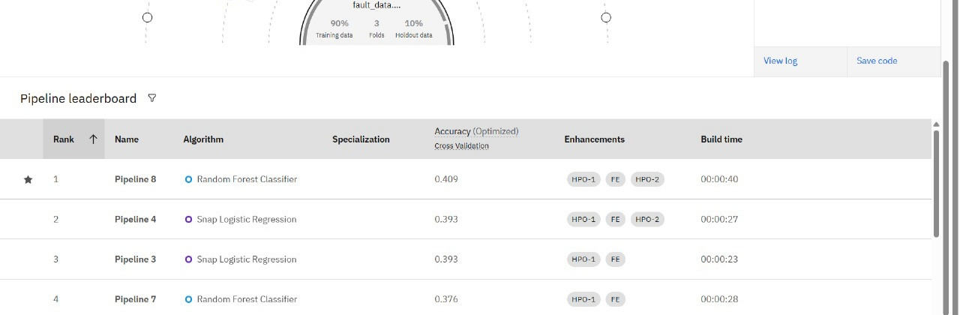
Result ( Output Image)

Slide 8
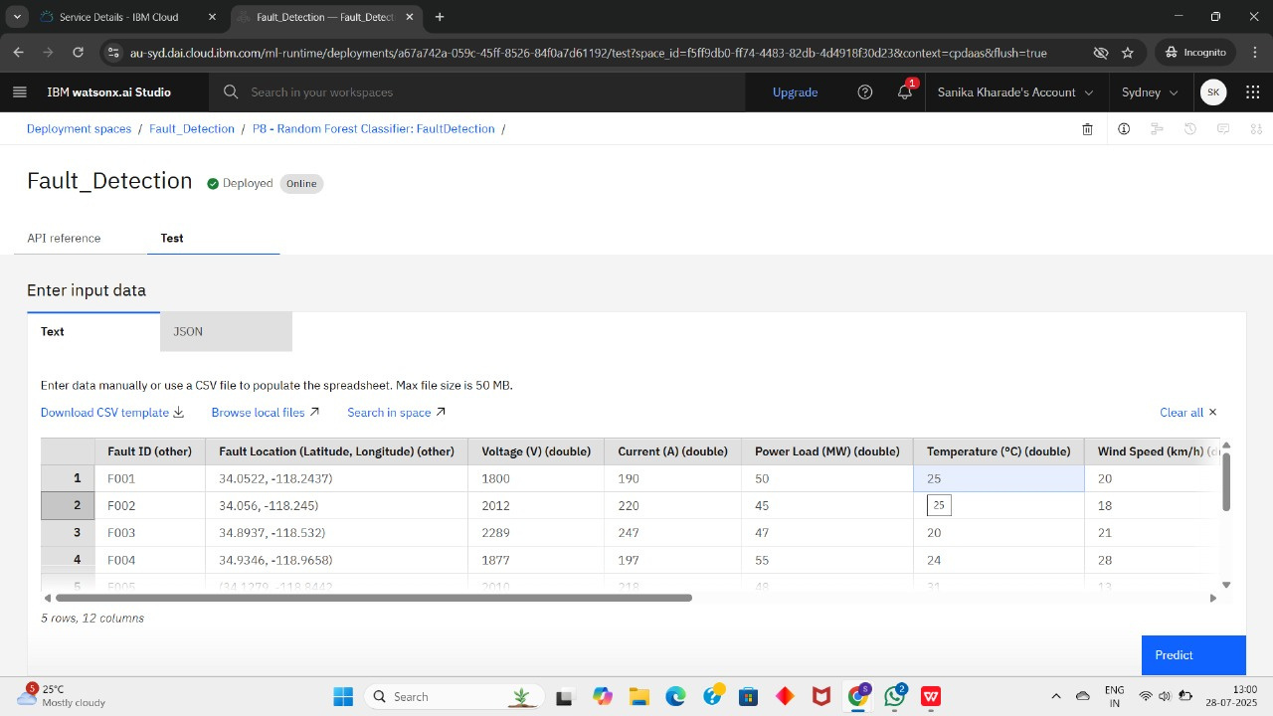

Slide 9
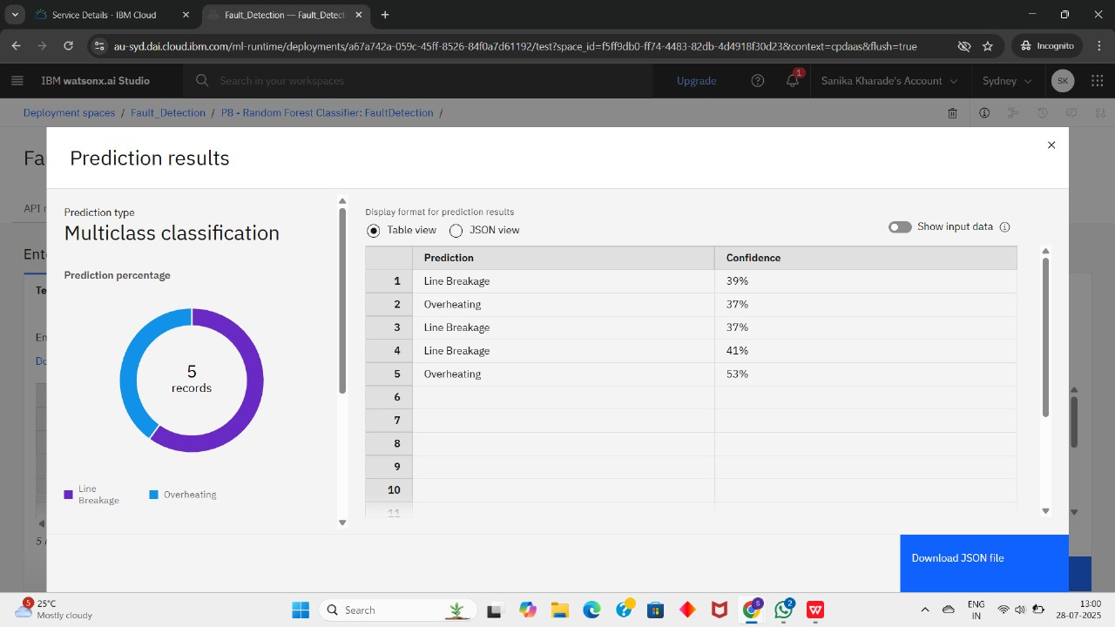

Slide 10
The project successfully demonstrated how AutoAI can automate model building for fault detection in power systems. The final model achieved high accuracy, and its API deployment allows real-time fault classification. IBM Cloud tools made development efficient and scalable.
Conclusion

Slide 11
Future scope
Integrate real-time streaming data using IoT sensors.
Expand the dataset to include more diverse fault types.
Use explainable AI (XAI) to interpret model decisions.
Deploy on edge devices for faster local responses in remote areas.

Slide 12
References
Kaggle Dataset: Power System Fault Detection.
IBM AutoAI Documentation.

Slide 13
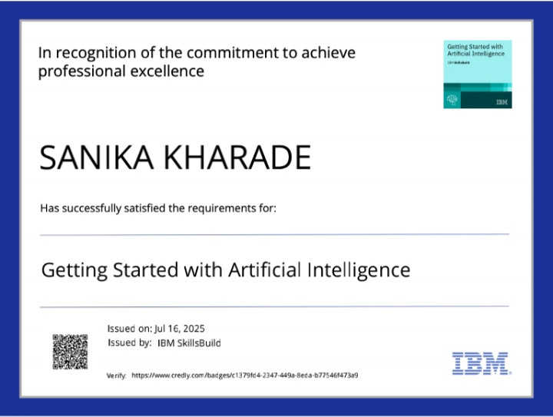
IBM Certifications

Slide 14
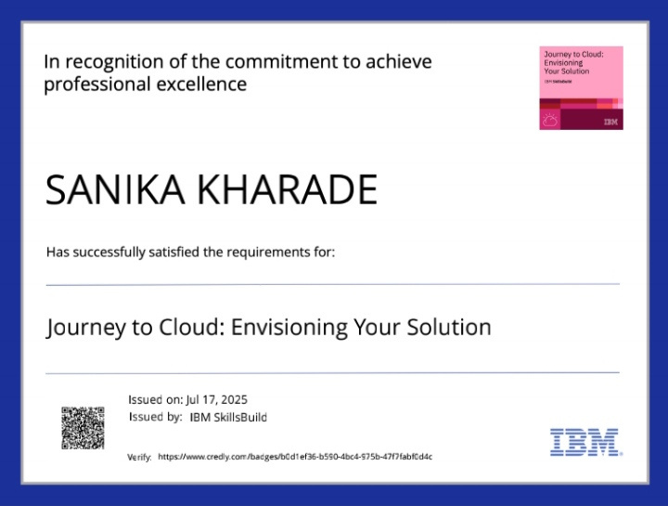
IBM Certifications

Slide 15
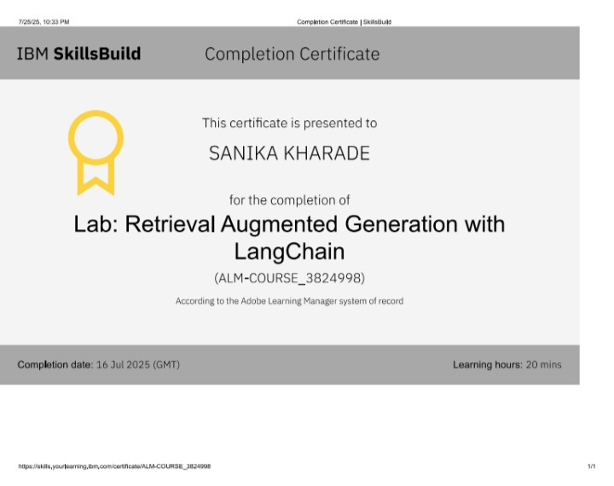
IBM Certifications

Slide 16


